Slide 1

OBJECT DETECTION USING OPENCV & YOLO
MUHAMMAD AHMED (20P-0189)

Slide 2
CONTENT
OPENCV & YOLO An Introduction
Objective
Problem & solution domain
Required resources
Preprocessing
Yolo framework
conclusion

Slide 3
OPENcv & yolo an introduction
OpenCV (Open Source Computer Vision Library) is an open-source computer vision and machine learning software library. It was first introduced in 1999 by Intel and is now maintained by the OpenCV community.
The library provides more than 2500 optimized algorithms that include a comprehensive set of both classic and state-of-the-art computer vision and machine learning algorithms.
It provides a wide range of functionalities for image processing, such as image filtering, feature detection, object detection, and more.
Cross-Platform - OpenCV can be used on different operating systems like Windows, Linux, and macOS.
YOLO (You Only Look Once) is an object detection algorithm that is widely used in computer vision applications. It is based on convolutional neural networks (CNN) and is capable of detecting objects in real-time video streams.
YOLO divides the input image into a grid of cells and predicts the object's class probabilities and bounding box coordinates for each cell.
This approach allows YOLO to detect multiple objects in an image in a single forward pass, making it much faster than other object detection algorithms.

Slide 4
OBJECTIVE
This program is designed to automatically detect and recognize objects within an image using the YOLO (You Only Look Once) algorithm. The algorithm uses deep neural networks to process the image and identify the location of each object along with its corresponding class label. The program aims to provide an efficient and accurate solution for object detection and classification in various computer vision applications.

Slide 5
Problem Domain
Humans can easily detect and Identify objects present in an image but for the computer or machine classifying and finding an unknown specific object within an image is a difficult task.
However there exists several object detection software, algorithm's and applications but not provide accurate results. Such as Sliding window, R CNN , Fast R CNN

Slide 6
Solution domain
This project involves the use of computer vision and deep learning techniques to develop an object detection program using the YOLO (You Only Look Once) algorithm.
This includes pre-processing the input image, applying the YOLO algorithm to identify objects, and then drawing bounding boxes around the identified objects.
The program requires the use of libraries such as OpenCV and NumPy for image processing and manipulation, and the YOLO weights and configuration files for object detection.
The true purpose of this project is that it can be used in security, surveillance and autonomous vehicle driving to detect pedestrians walking or jogging on the street to avoid accidents .

Slide 7
Required resources
A computer with a CPU and GPU (preferably Nvidia GPU) capable of running deep learning algorithms.
OpenCV library for image processing.
Darknet framework for implementing YOLO algorithm.
COCO dataset for object detection.
Pre-trained YOLO model weights.
Coco.names file containing the names of the objects present in the COCO dataset.
A text editor or IDE for writing and executing the code.
Sufficient storage space to store the required dataset and trained model weights.

Slide 8
Pre-processing
The preprocessing step involves loading the input image, resizing it to fit the input size of the YOLO model, and normalizing the pixel values of the image to be in the range [0, 1].
Additionally, the program loads the YOLO model and retrieves the output layer names. These steps prepare the image and the model for object detection.

Slide 9
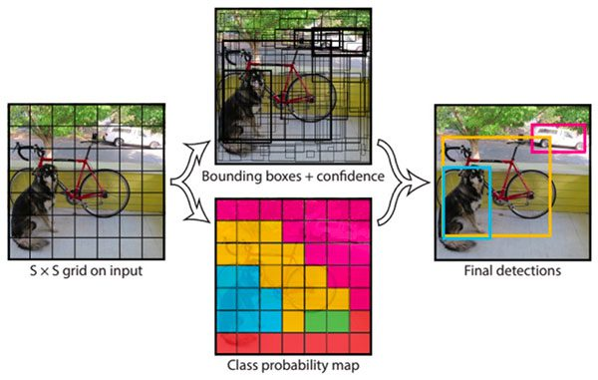
Yolo framework
YOLO (You Only Look Once) is an object detection system that uses a single neural network to predict bounding boxes and class probabilities for objects in an image. It divides an image into a grid of cells and predicts bounding boxes, class probabilities, and confidence scores for each cell.
The network uses convolutional layers to extract features from the input image and then applies a series of fully connected layers to predict the classes and bounding boxes.
YOLO is fast and accurate and can detect objects in real-time. It has been widely used in a variety of applications, including self-driving cars, robotics, and surveillance systems.

Slide 10
Conclusion
In conclusion, this project successfully utilizes the YOLO (You Only Look Once) object detection algorithm to identify objects in an image. The program processes the image using OpenCV library, detects objects using the pre-trained YOLO model, and returns the output image with identified objects and their corresponding labels.
This project can be used for various applications, such as security systems, self-driving cars, and even in the entertainment industry for special effects. Additionally, the program can be further optimized to enhance its performance and accuracy. Overall, this project showcases the potential of computer vision and object detection algorithms in various fields.

